Slide 1
PROJECT
Real-time Face Detection and Recognition
Group Member:
Muhammad Umer EP-1449081
Khalid Bin Huda EP-1449041

Slide 2
Application for Face-Detection and Recognition or QR Code that help to organize and manage any event. With Machine Learning

Slide 3
FINAL YEAR PROJECT
Overview
INTRODUCTION
Why? ,PROBLEM
TECHNOLOGY USED
WORKING
FRONTEND
PROCESS
APPLICATION

Slide 4

WHY! (or) Problem It Solve
Invited only Conference and Event (A LOT OF WORK)
PEOPLE
WAITING
AT
GATE
Steps
1) Form Submission
2) Confirmation Email
3)Need A lot of volunteers
4) Waste of time in checking people identity Cards at Gate
5) Marking Their attendance for Certificate

Slide 5
Invited only Conference and Event (A LOT OF WORK)
WHY! (or) Problem It Solve
Steps
1) Form Submission
2) Confirmation Email
3)Need A lot of volunteers
4) Waste of time in checking people identity Cards at Gate
5) Marking Their attendance for Certificate
Our Project (less work, Automatic)
Steps
1)Fill Form online
2) Need A Camera At Gate
DONE

Slide 6
Technology Used
JAVA,PYTHON
SPRING BOOT for Web-App
PYTHON for Face-Recognition
Open-CV for computer vision
MYSQL for Database

Slide 7

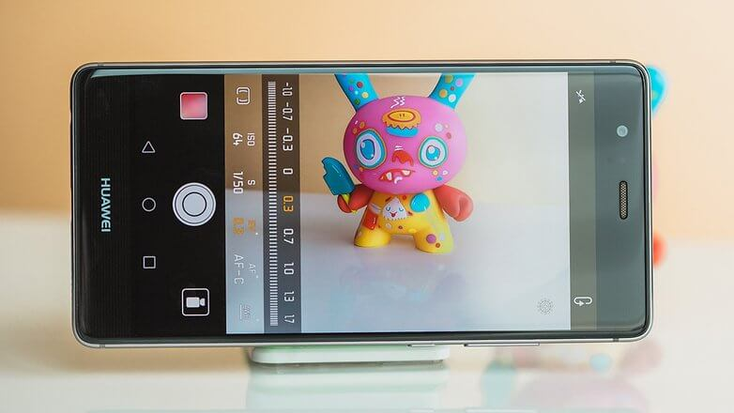
INPUT
Mobile Camera with HTTP VIDEO STREAM
Or Web-cam

Slide 8
TWO Step Process
First: face detection
Second: face Recognition
Input image -> detection -> recognition -> classification

Slide 9
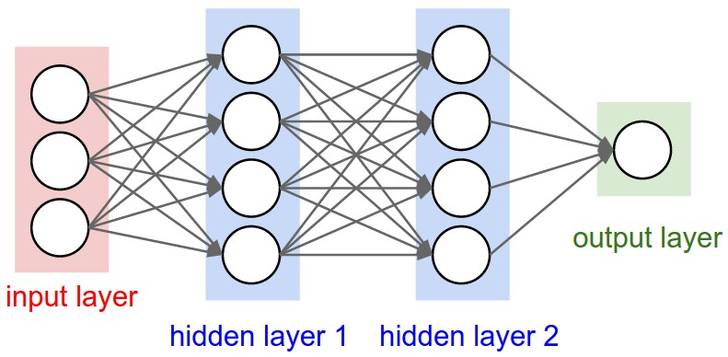
TWO Step Process
First: face detection
Second: face Recognition
We Used
Deep Learning and Convolutional Neural Networks and
Consist of neurons
Neuron is a mathematical function
Brandon Amos`s Pre Trained Model

Slide 10
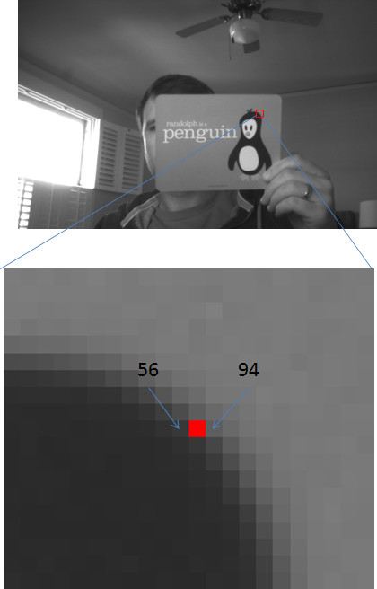
TWO Step Process
First: face detection
Second: face Recognition
For Face Detection in a Picture it use HOG (histogram of oriented gradients)algorithm
In Greyscale
Gradient Vector
a measure of the change in pixel values along the x-direction and the y-direction around each pixel.

Slide 11
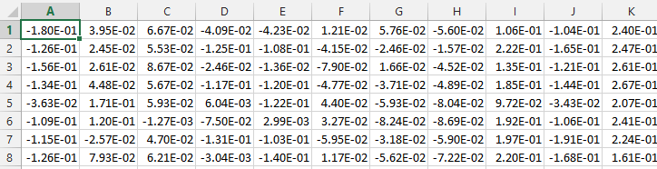
Steps
1)Load image file as Numpy Array (pixels)
2) Neural Network gives features of the face and
Multi-dimensional Encoding
3)Now Classify and predict face

Slide 12

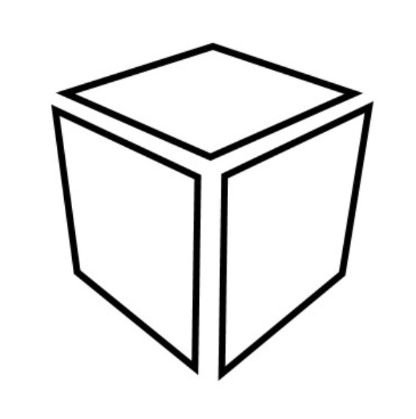

Compare Face and Classify
ML Model
match with closest measurement

Slide 13
After Classifying the face
It check weather the person in Database
And
if it is in Database then It display the name of the person
And
add a entry in database
otherwise it display unknown
Saad ahmed

Slide 14
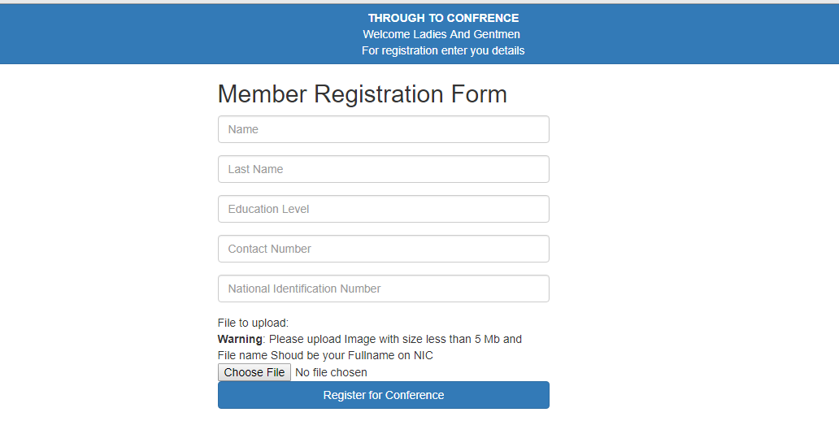
Process For The Application
Form For Registration
Insert photo

Slide 15
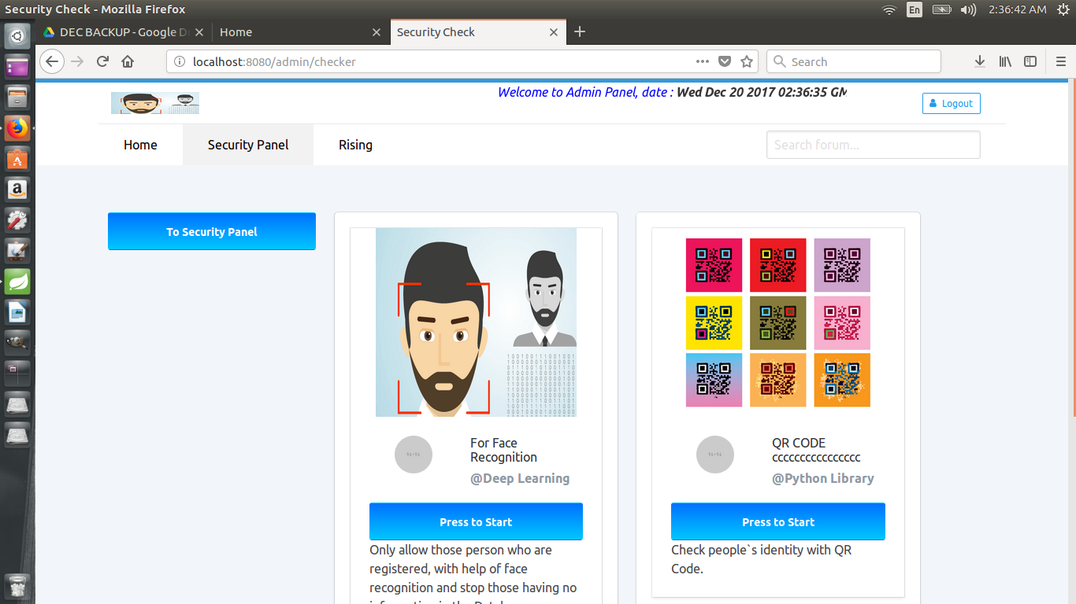
Process
Control Panel

Slide 16
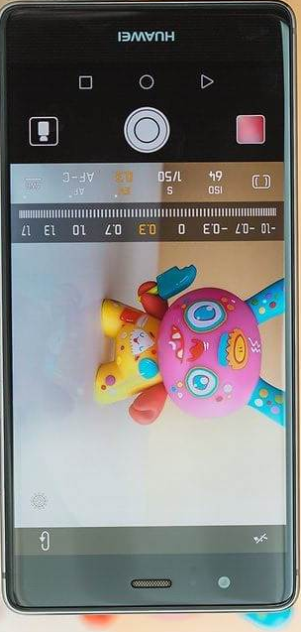
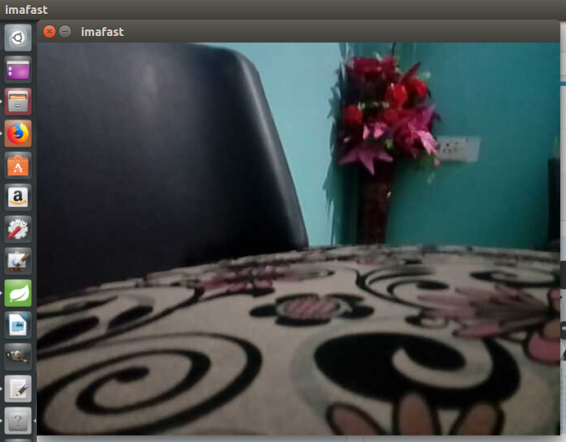
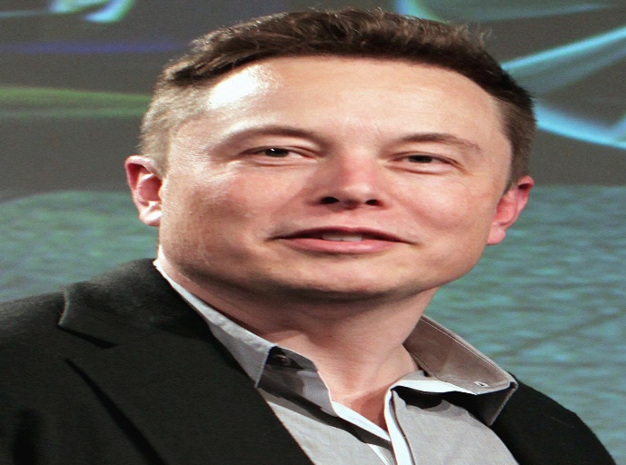



Flow
Mobile Camera
HTTP
Face
Elon Musk
Predict person Face
ML Model

Slide 17
APPLICATION OF THE PROJECT
1- Help To Organize any Conference (which allow only Register Member)
2- Online Testing
3- Attendance System

Slide 18
Questions?

